Slide 1

Major Project:
ONLINE TECH TURING PORTAL(OTTP)
Presented By
MOHD ARSHAD (1305010434)
MOHD ASHJAD SHAHAB (1305010435)
(B.Tech 4th year)
Under the Guidance of
Dr. Muqeem Ahmed
Assistant Professor
CS & IT, MANUU

Slide 2
Introduction
ONLINE TECH TURING PORTAL(OTTP) is a annual tech fest web portal that can be used by Dept./Institute/organization to conduct Events like online debugging, poster presentation, technical presentation, innovation, technical quiz, flash mob. Where student can register and participate in various events and also student can see results of events at one place.Through OTTP we can conduct online debugging.

Slide 3
Objective
The main purpose of OTTP project is to reduce pen and paper work.and provide events details at one place where student can easily find the details of events and also can register for various events from anywhere and also can see the various events result.
OTTP also can conduct debugging event which will help to reduce the time and work load of event coordinators and will produce result instantaneously.

Slide 4
Modules
Admin Module
Registration Module
Login and Forgot Password Module
Workshop/Seminar Module
Events Module
Online Debugging Module
Result Module
Contact us/Feedback Module

Slide 5
IMPROVEMENT OVER THE EXISTING IMPLEMENTATION
Present State
No Software/GUI present.
More time taken to registration of students through paper based registration forms.
Time consuming in access the records of the students.
Students are informed by sending mail to them manually.
Manual creation of lists according to their Groups.
To verify the students registration details it takes lot of time waste.
Pen and Paper mode quiz,results and other informations.
Cont...

Slide 6
After implementation of project:
Easy to use through GUI.
Online Registration so that student can register from anywhere it reduces traveling time and cost.
Students can get informed by email automatically.
Online debugging,results,and other informations.
Reduces the pen and paper based works.

Slide 7
Conclusion & Future Scope of the project
Conclusion
Online Tech Turing Portal is very useful for the participant and coordinators. It reduces the time and paper based work. All the details of Events are at one place.
Future Scope
The future scope of the Online Tech Turing Portal is, we can organnize the events to the university level where student can easily register and get the information about the Events detail. From this project University renown will increases.

Slide 8
SYSTEM REQUIREMENT
Hardware requirements
Processor :Intel Pentium and above.
RAM: 1 Gb
HardDisk: 250 Gb and above.
Software Requirements
Operating System: Windows 7 or later
IDE: NetBeans IDE 7.3.1version
SERVER: GlassFish Server
DataBase: MySql 4.5.1version
User Interface: HTML,CSS,JAVASCRIPT
Code Behind: JAVA,JSP

Slide 9
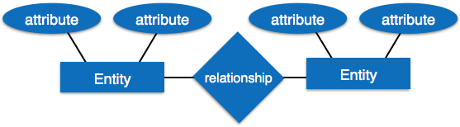
Entity-Relationship Diagram
Entity-Relationship model is a type of database model based on the notion of real world entities and relationship among them. We can map real world scenario onto ER database model.
ER Diagram respresents as:

Slide 10
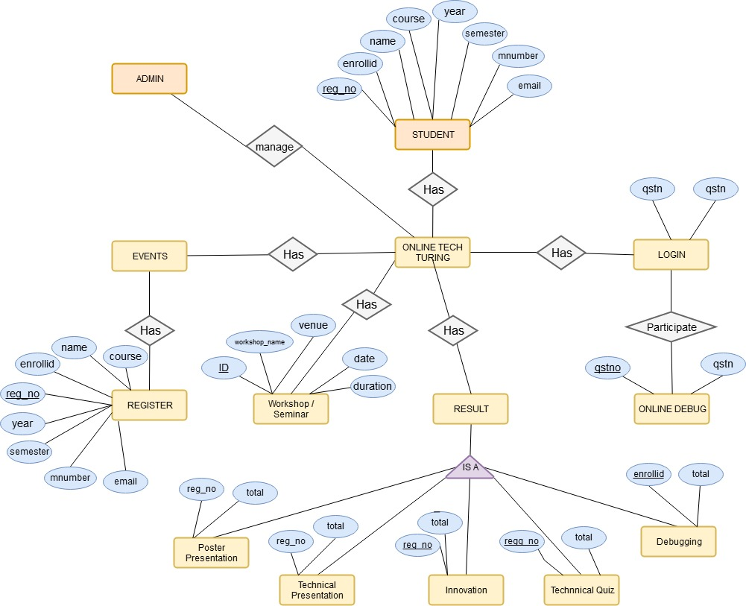
Entity-Relationship Diagram Cont..

Slide 11
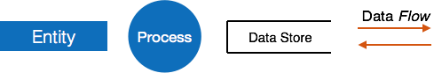
DFD(Data Flow Diagram)
Data flow diagram is graphical representation of flow of data in an information system.
The DFD does not mention anything about how data flows through the system.
DFD Components:
DFD Levels:
Level 0
Level 1
Level 2

Slide 12
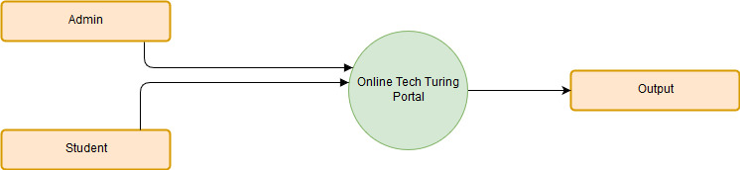
DFD(Data Flow Diagram) Cont..
Online Tech Turing Portal
Context Level DFD

Slide 13
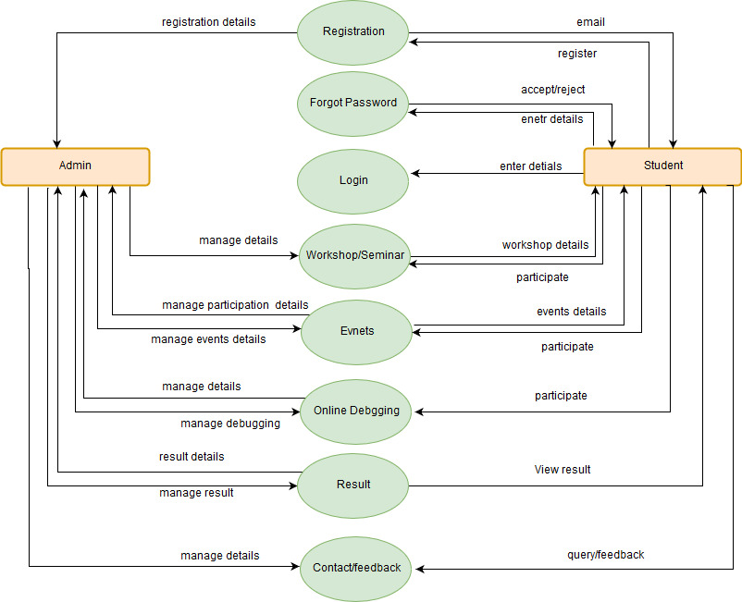
DFD(Data Flow Diagram) Cont..
Level 1 DFD

Slide 14
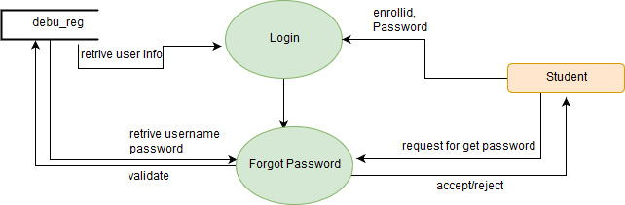
DFD(Data Flow Diagram) Cont..
Level 2 DFD (Login)

Slide 15
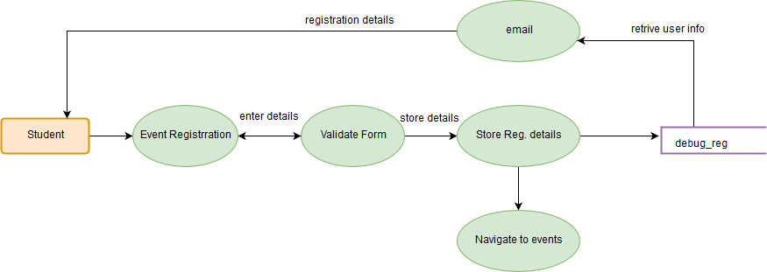
DFD(Data Flow Diagram) Cont..
Level 2 DFD (registration)

Slide 16
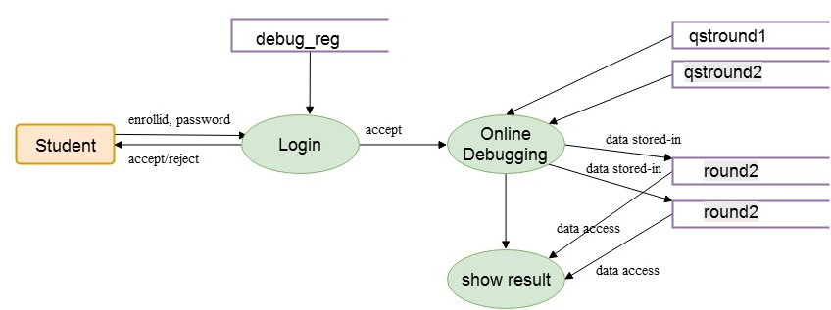
DFD(Data Flow Diagram) Cont..
Level 2 DFD (Online Debugging)

Slide 17
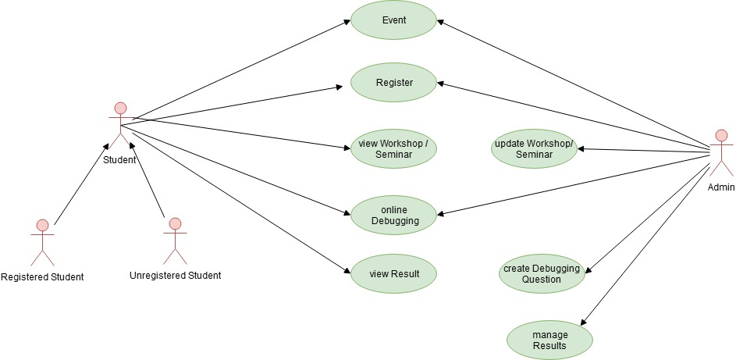
UML DIAGRAM
Use Case Diagram: Student & Admin

Slide 18
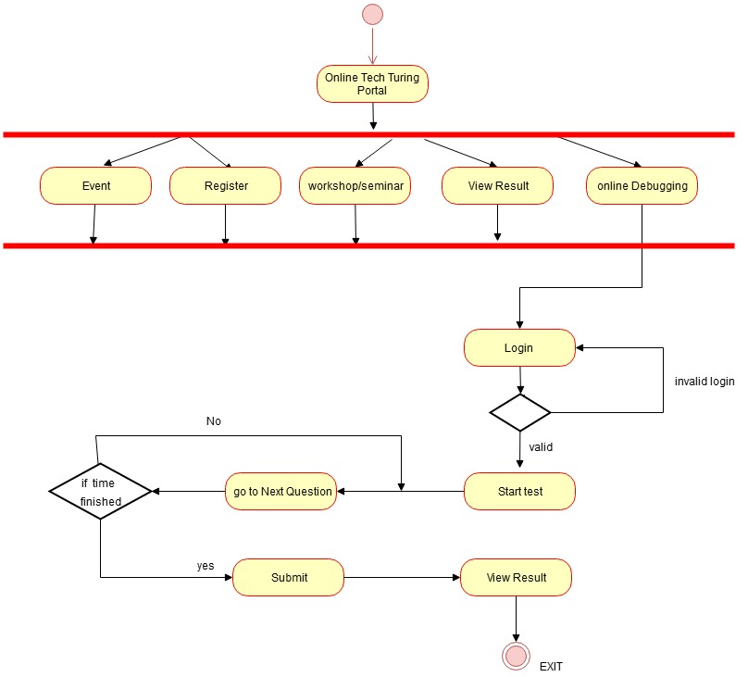
UML DIAGRAM(Cont...)
Activity Diagram: Student

Slide 19
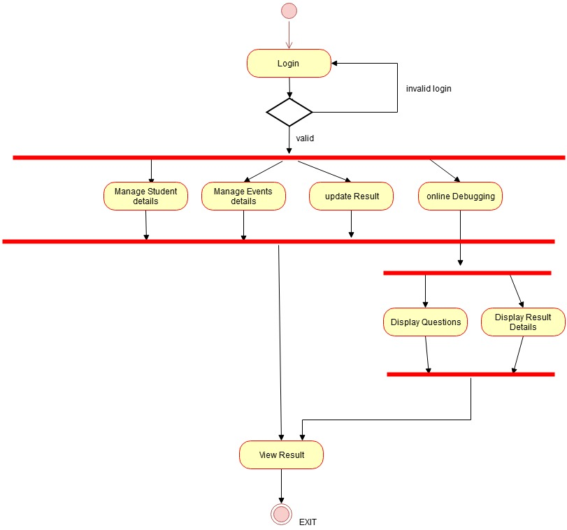
UML DIAGRAM(Cont...)
Activity Diagram: Admin

Slide 20
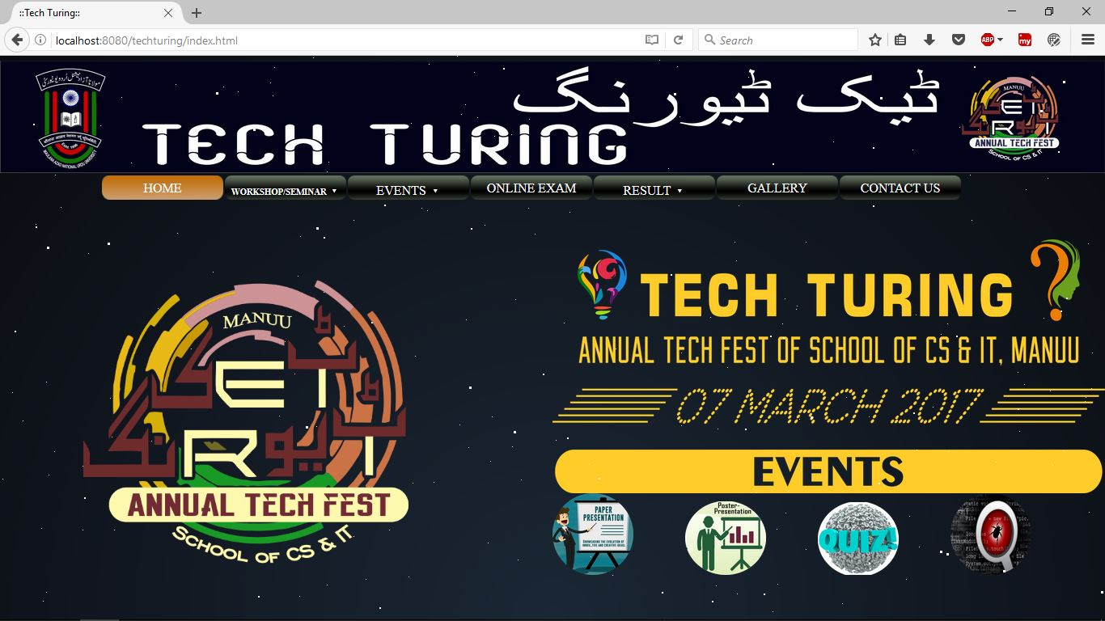
Screenshots
Homepage

Slide 21
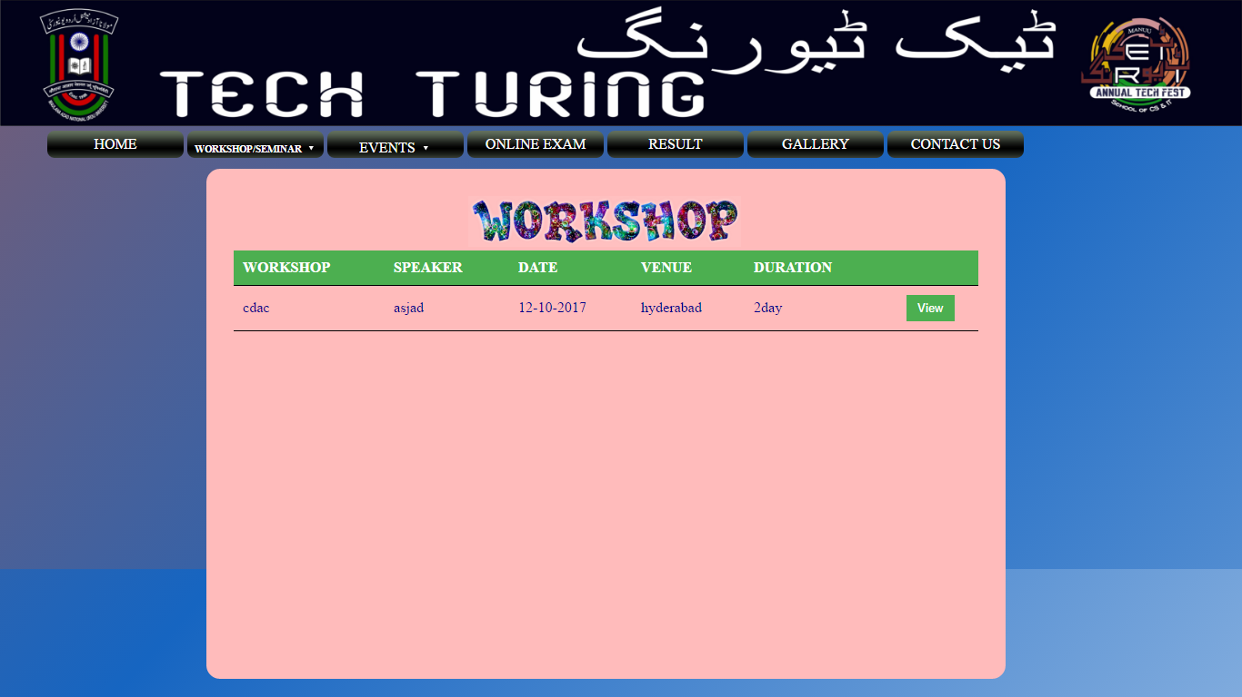
Screenshots(Cont...)
Workshop

Slide 22
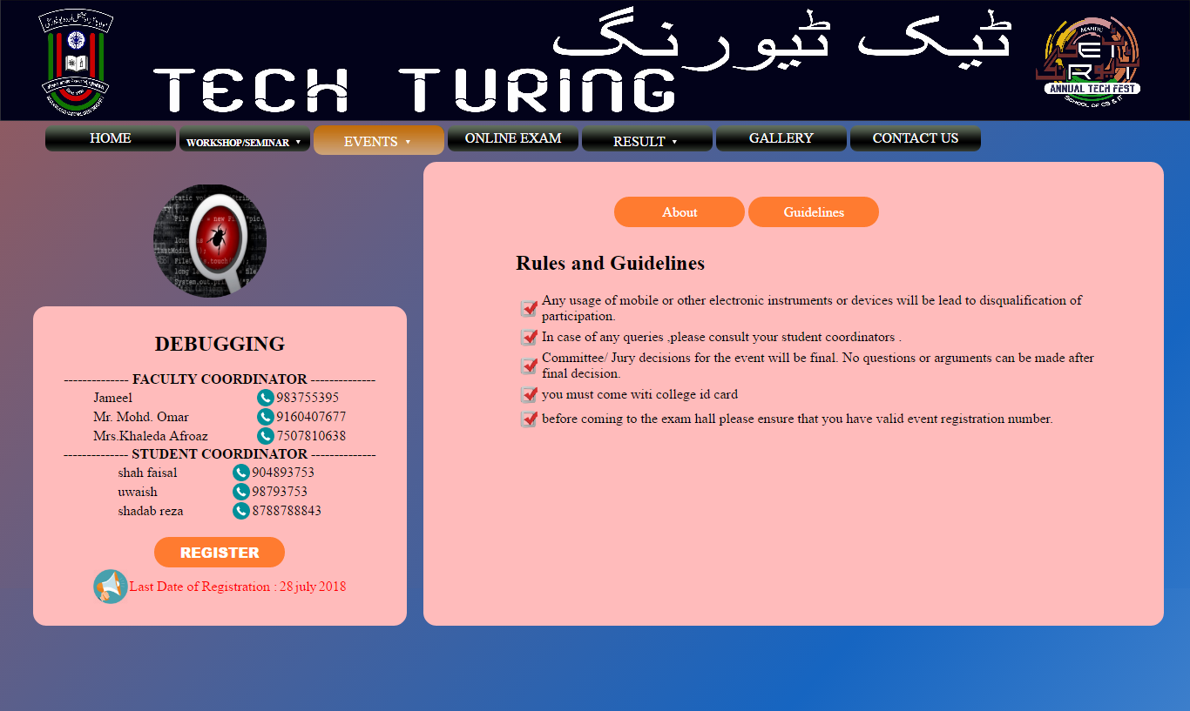
Screenshots(Cont...)

Slide 23
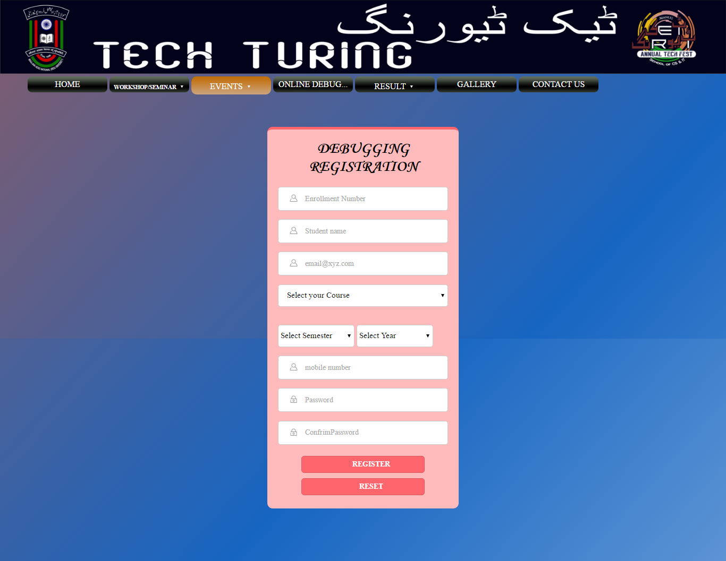
Screenshots(Cont...)

Slide 24
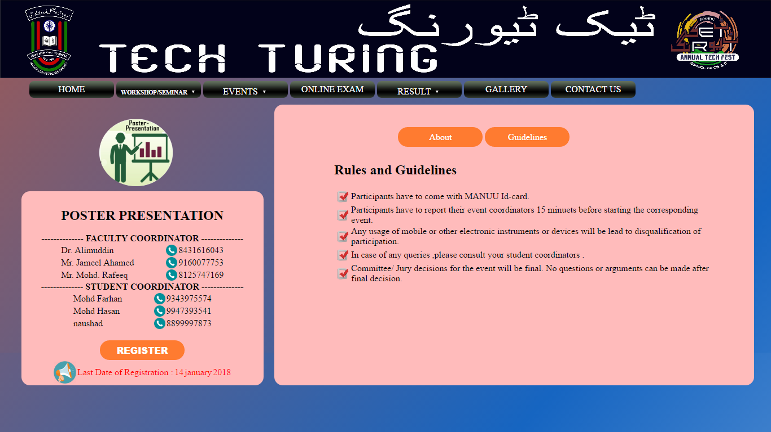
Screenshots(Cont...)

Slide 25
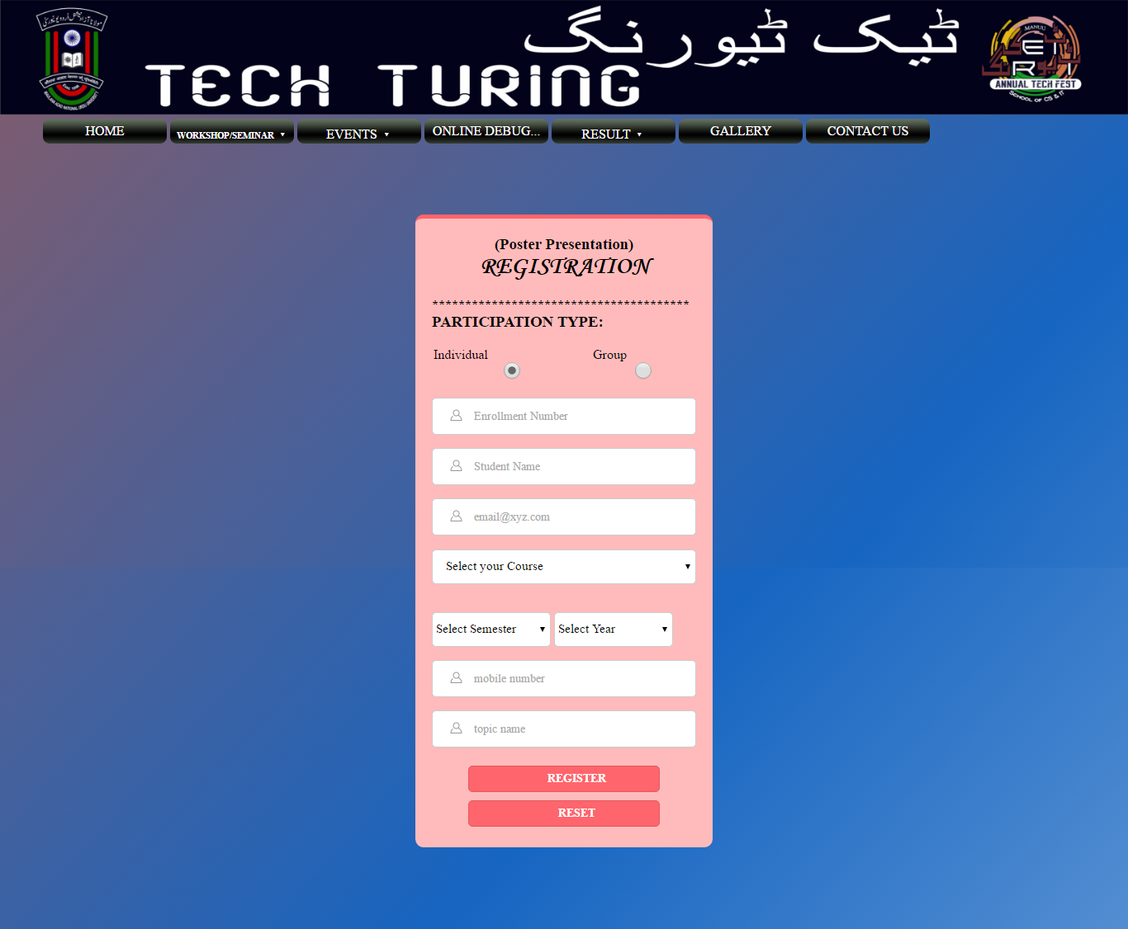
Screenshots(Cont...)

Slide 26
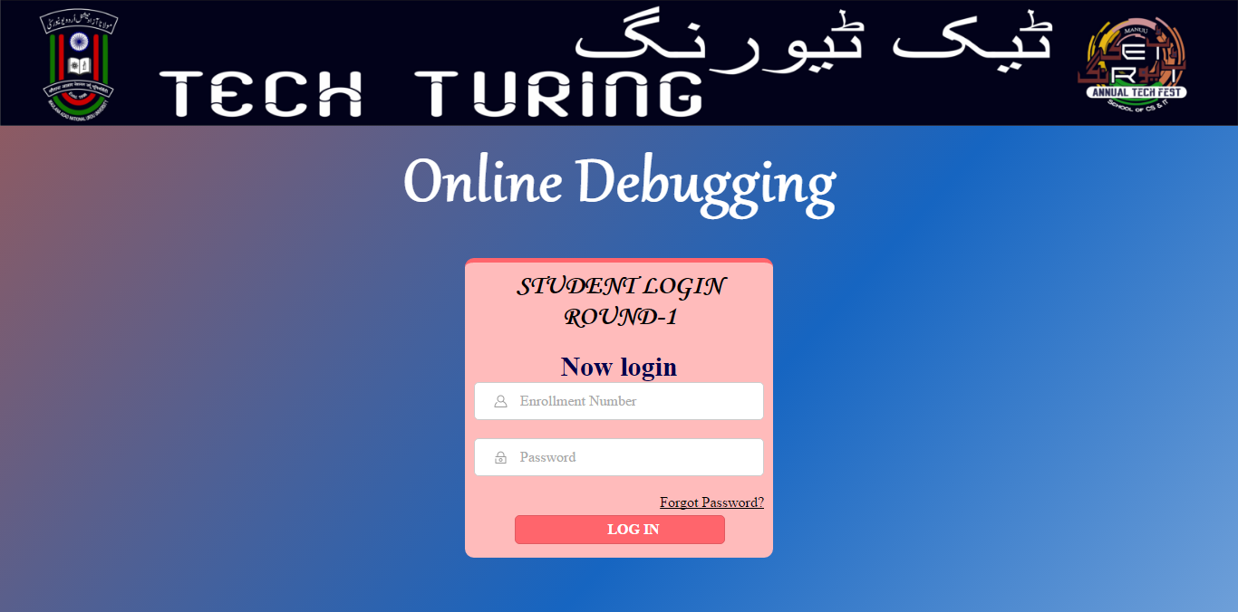
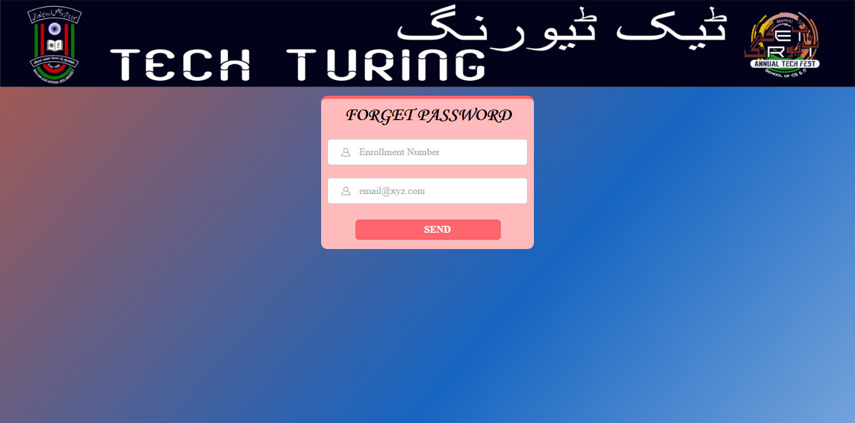
Screenshots(Cont...)

Slide 27
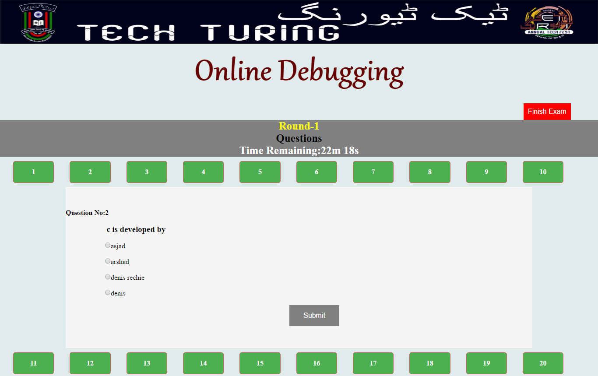
Screenshots(Cont...)

Slide 28
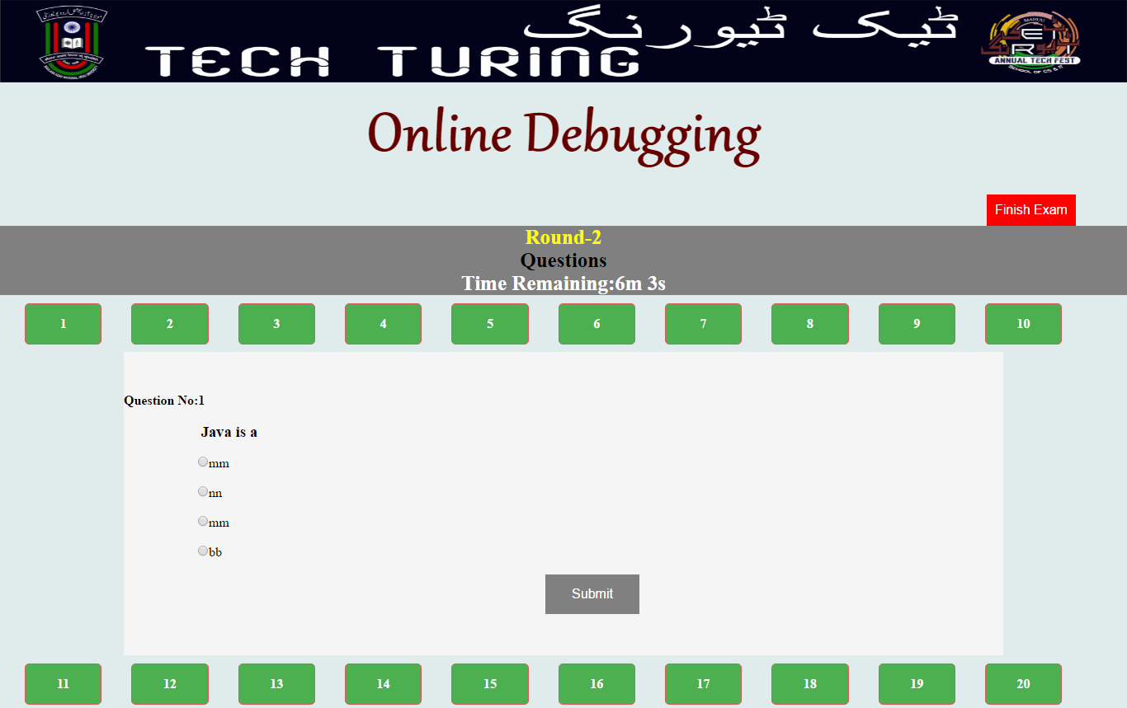
Screenshots(Cont...)

Slide 29
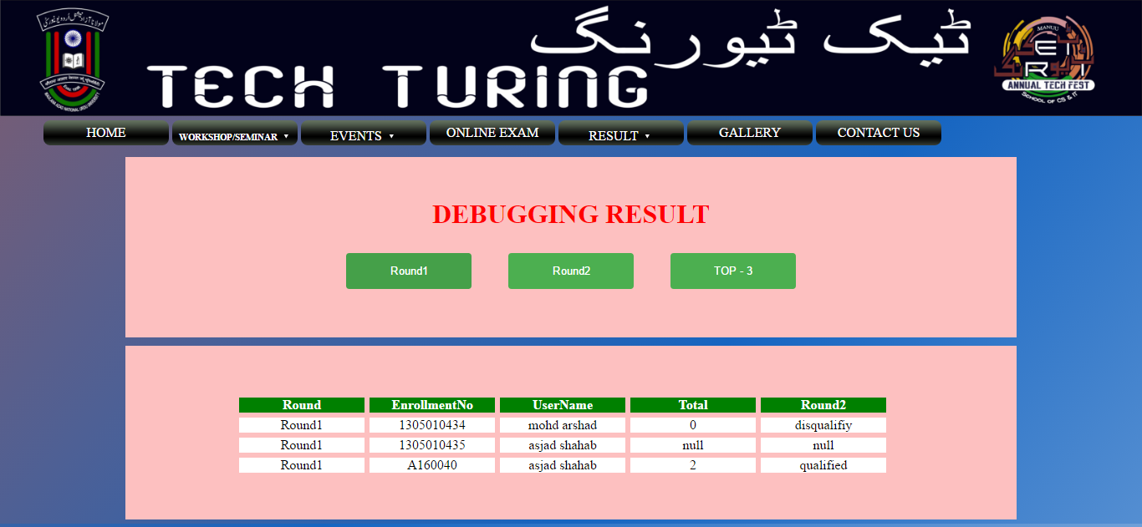
Screenshots(Cont...)

Slide 30
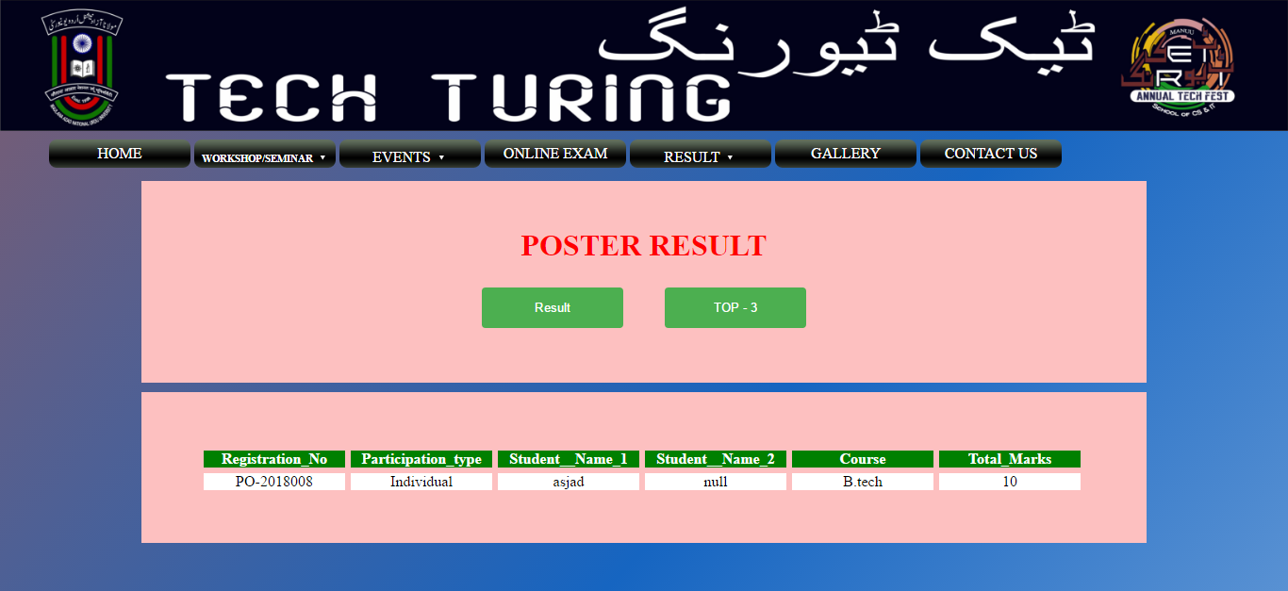
Screenshots(Cont...)

Slide 31
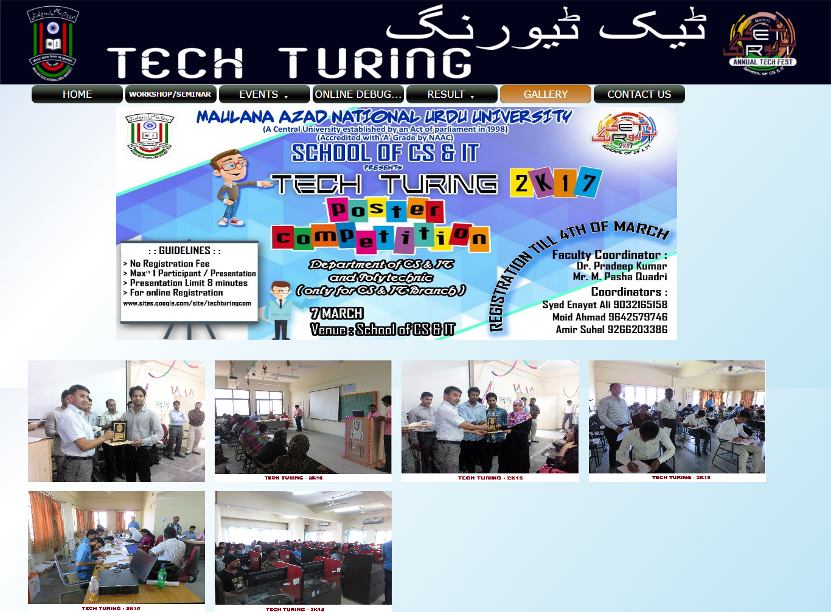
Screenshots(Cont...)

Slide 32
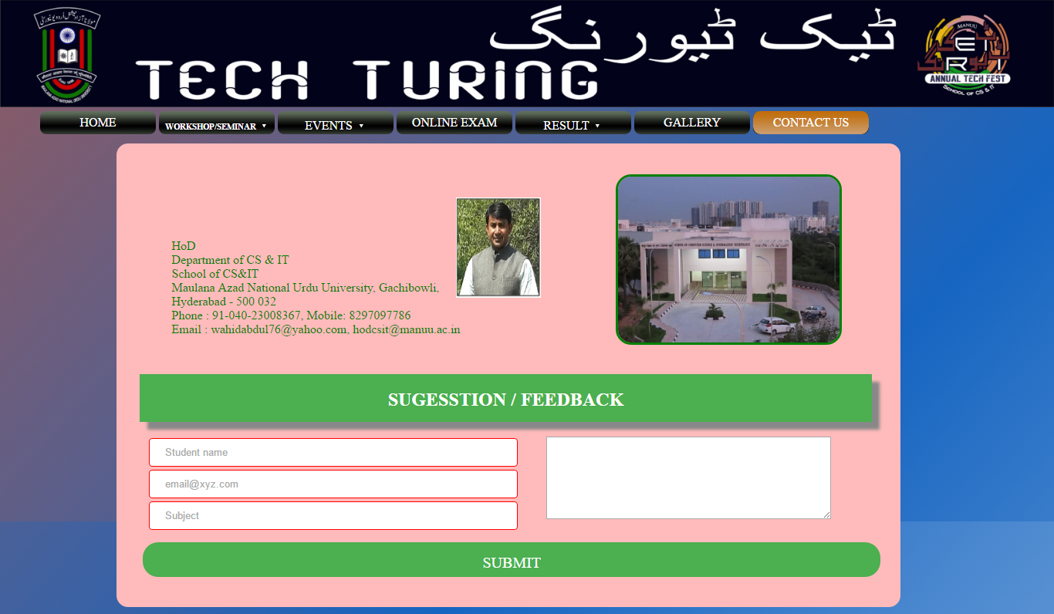
Screenshots(Cont...)

Slide 33
References:
www.stackoverflow.com
www.javatpoint.com
www.tutorialspoint.com
www.w3school.com
www.learnjavaonline.org
www.codcademy.com
www.studytonight.com
www.tutorialcup.com
www.htmlgoodies.com

Slide 34
THANK YOU......
ANY QUESTION OR SUGGESTION..???

